Slide 1


BLOCK CHAIN
PRESENTED BY
SOLIYA SHAIK(22AM1A0597)
SARITHA SANGEM(22AM1A0591

Slide 2

Agenda
CORE CONCEPTS IN BLOCKCHAIN
5
1
HISTORY
6
PROS AND CONS
2
BLOCK CHAIN
HOW DOES IT WORKS
7
APPLICATIONS
3
TYPES OF BLOCKCHAIN
8
REAL TIME EXAMPLE
4
9
conclusion

Slide 3
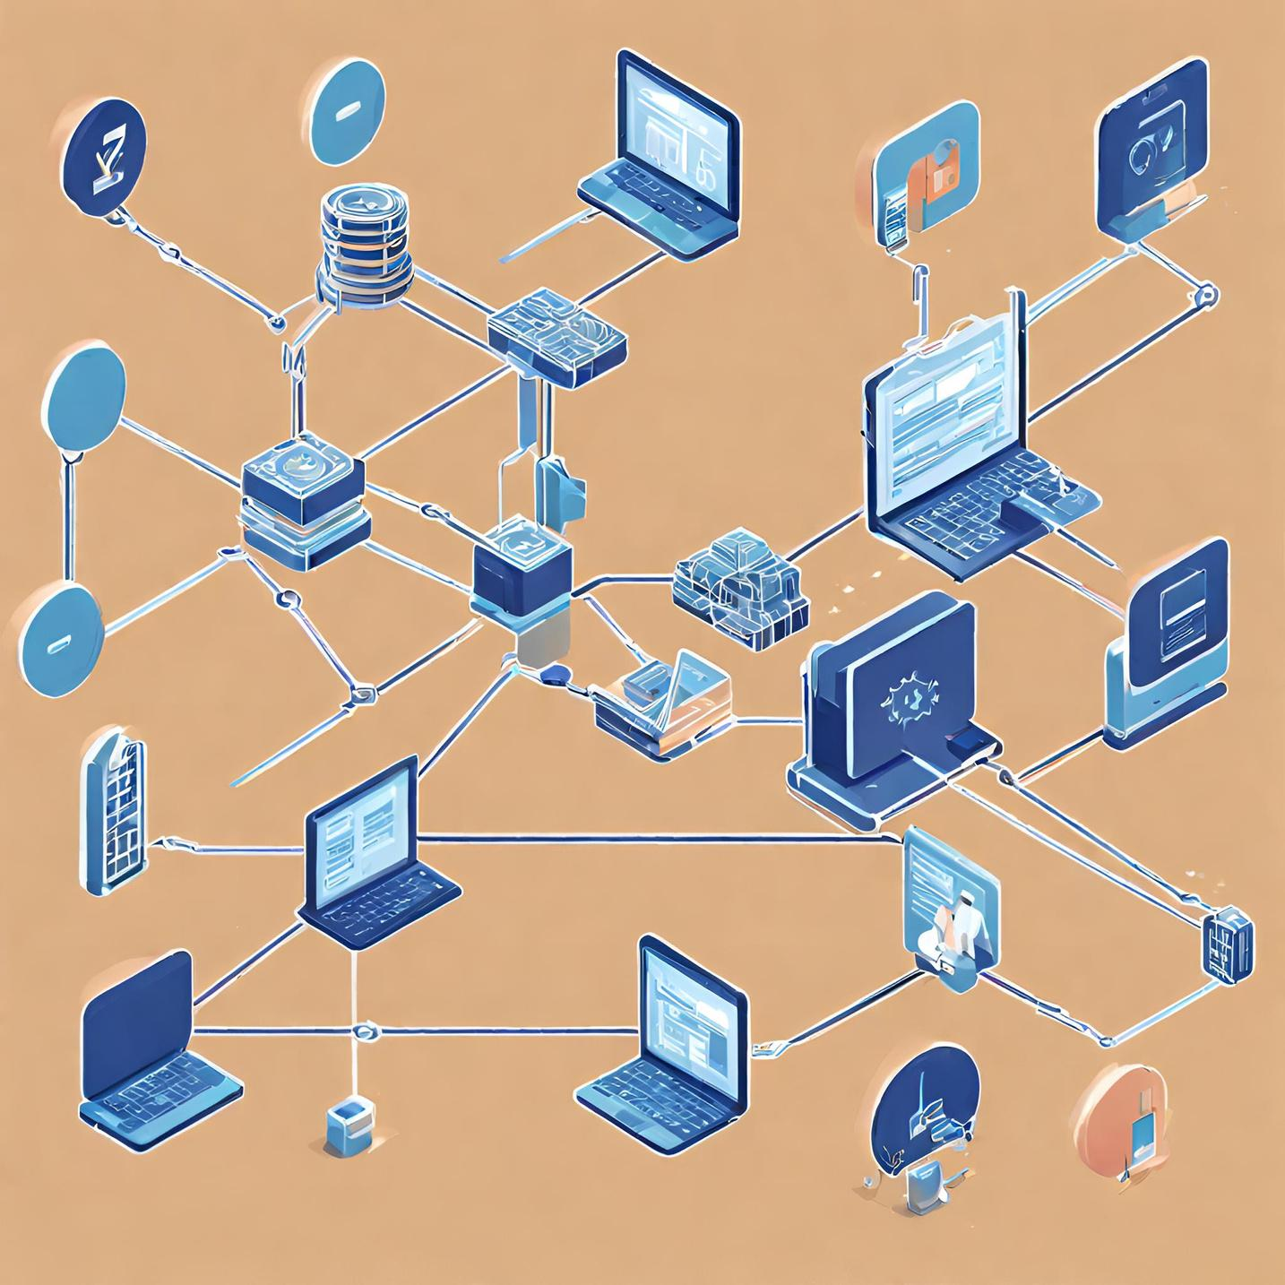
HISTORY
The first decentralized blockchain was conceptualized by a person (or group of people) known as Satoshi Nakamoto in 2008

Slide 4

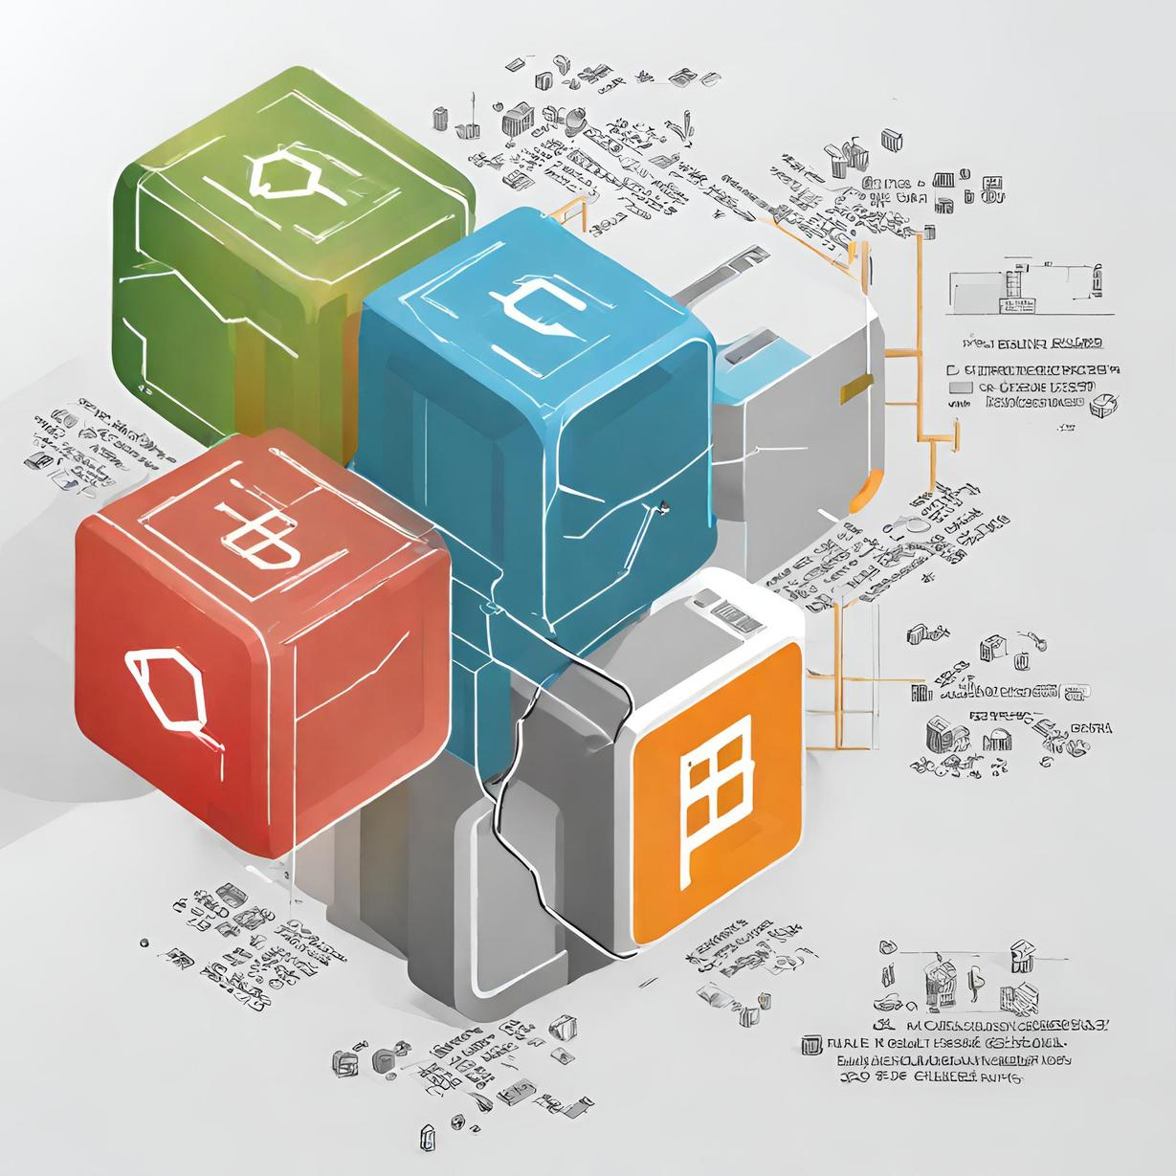
WHAT IS BLOCK CHAIN
Blockchain is a secure database shared across a network of participants, where up-to-date information is available to all participants at the same time.
Blockchain technology is a structure that stores transactional records, also known as the block, of the public in several databases, known as the “chain,” in a network connected through peer-to-peer nodes. Typically, this storage is referred to as a ‘digital ledger.’
In the digital ledger is like a Google spreadsheet shared among numerous computers in a network, in which, the transactional records are stored based on actual purchases. The fascinating angle is that anybody can see the data, but they can’t corrupt it.

Slide 5

HOW DOES IT WORKS
Blockchain is a combination of three leading technologies:
Cryptographic keys
A peer-to-peer network containing a shared ledger
A means of computing, to store the transactions and records of the network
Cryptographic keys consist of two keys – Private key and Public key. These keys help in performing successful transactions between two parties
A peer-to-peer network is based on the concept of decentralisation, which allows the participants to conduct transactions without needing a central server.

Slide 6
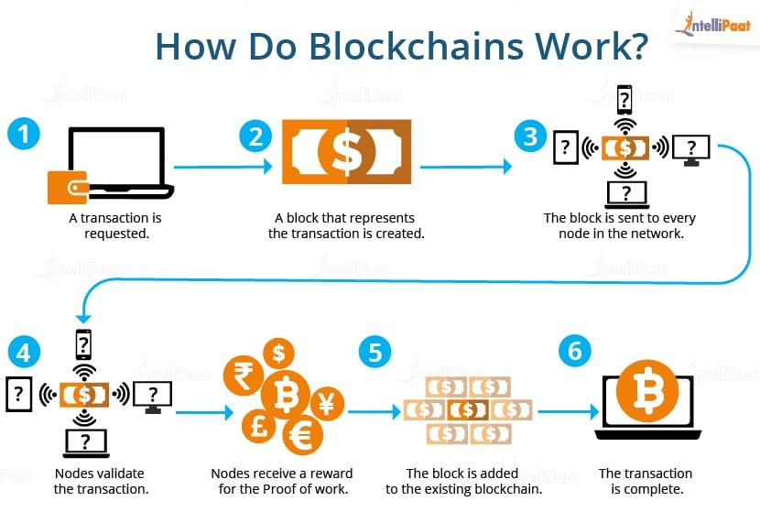

Slide 7
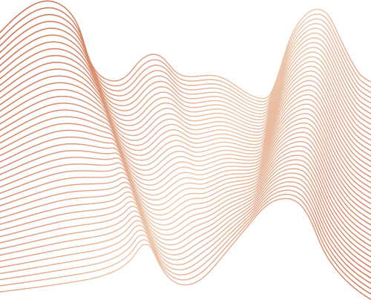
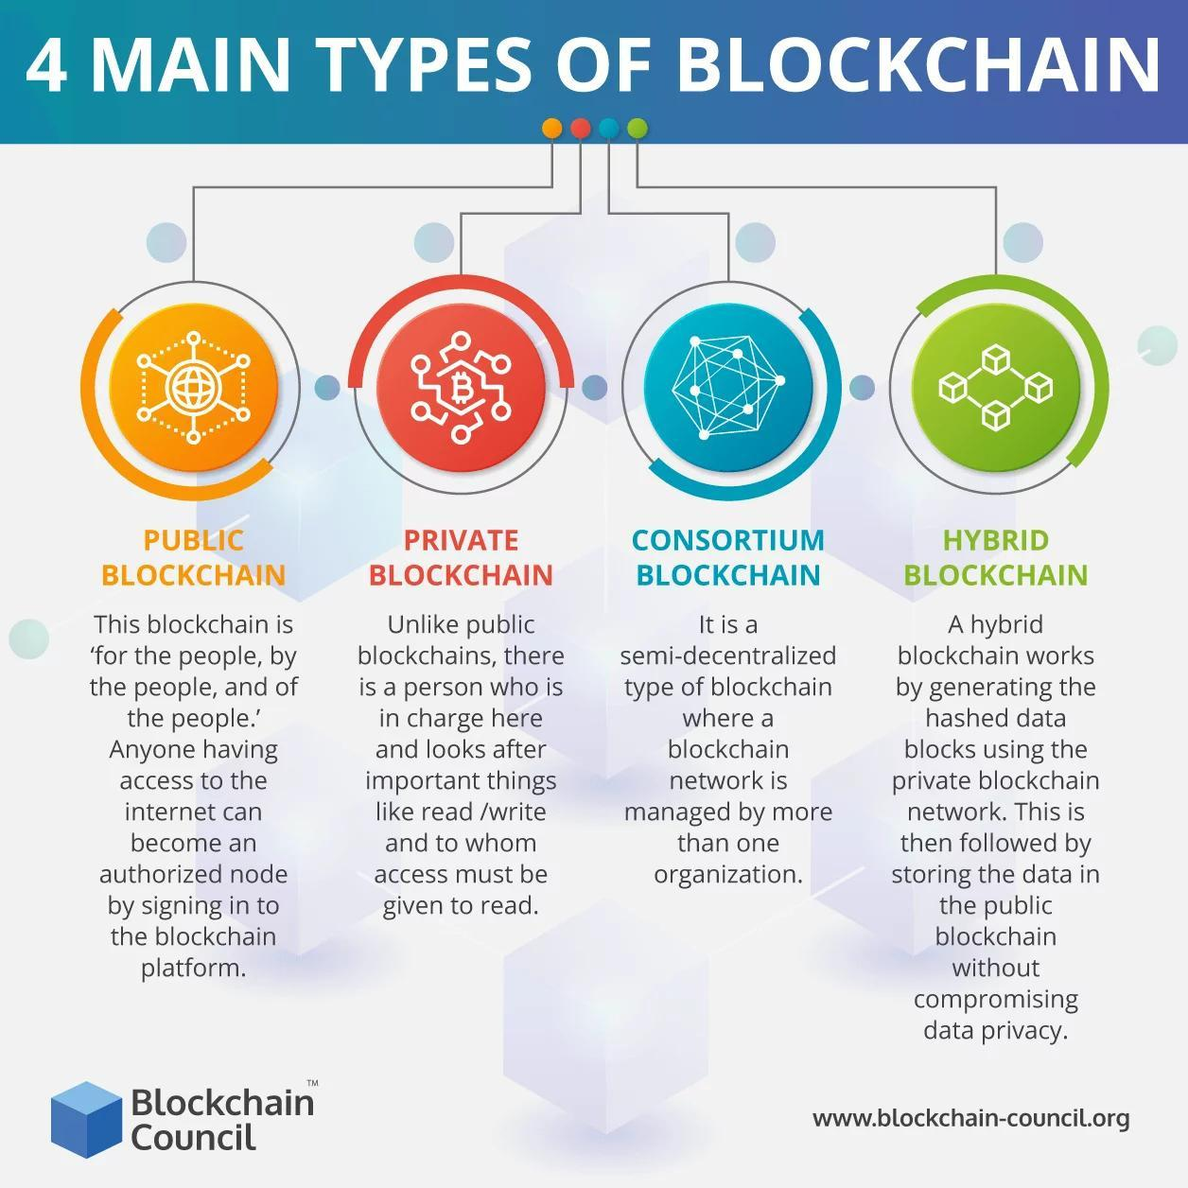

TYPES OF BLOCKCHAIN

Slide 8
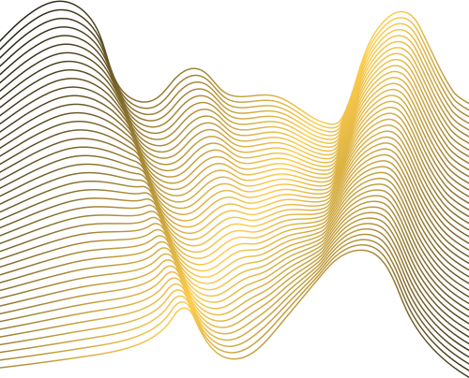
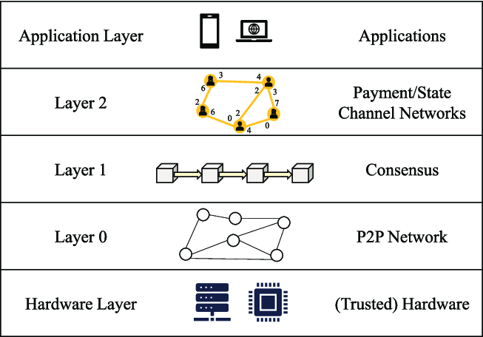
CORE CONCEPTS IN BLOCK CHAIN

Slide 9
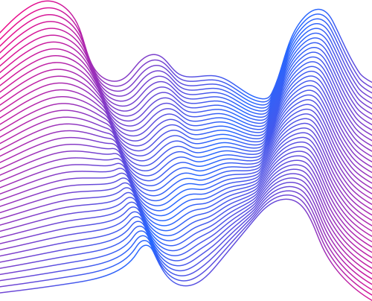
IMMUTABILITY
EFFICIENCY
COST REDUCTION
PROS
OPEN
SECURITY
PERMANENT

Slide 10
TIME CONSUMING
CONS
ENERGY CONSUMING
STORAGE

Slide 11
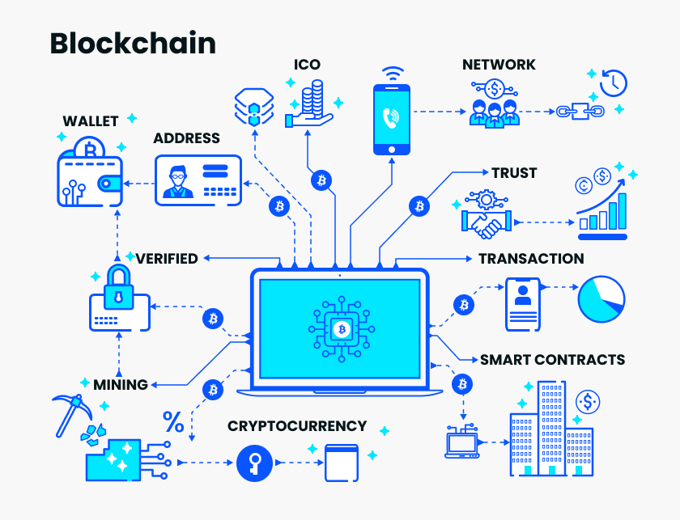

APPLICATIONS
Money transfers
Real estate
Securely share medical information
Secure Internet of Things networks

Slide 12
REAL LIFE EXAMPLE
Blockchain tech can keep track of serial and batch numbers of prescription drugs. Hospitals have moved away from paper for record-keeping, and they use blockchain technology to store patient data, which is kept confidential. The patient will be given a digital ID or a number key to access these records. Thus, Blockchain gives the patient control over who can see that data. The patient's diagnosis can also be stored so that the patient's health history can be tracked

Slide 13

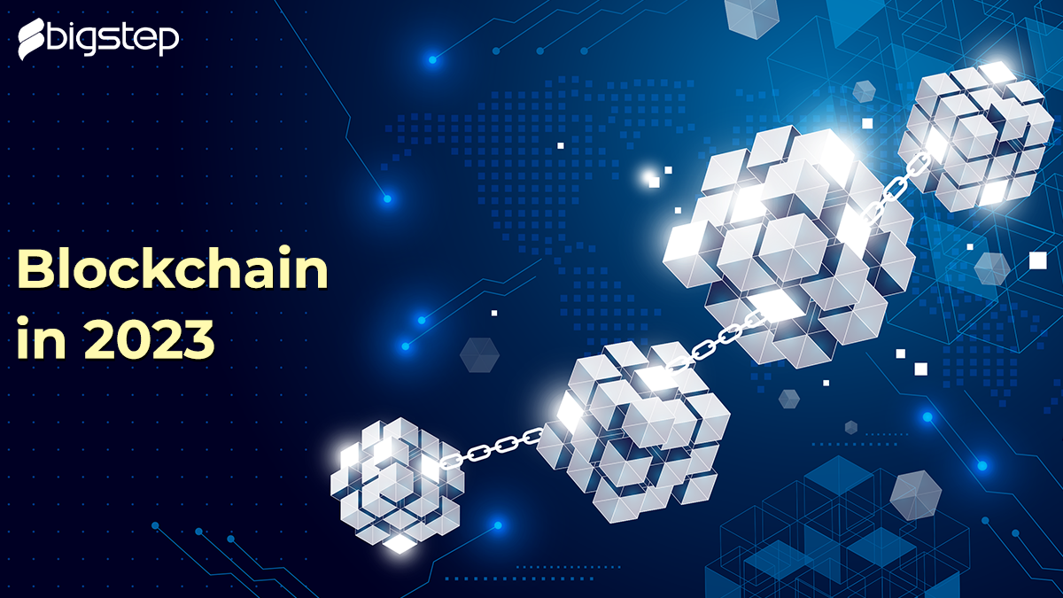
CONCLUSION
Blockchain helps organizations understand their supply chain and engage consumers with real, verifiable, and immutable data. Transparency builds trust by capturing key data points, such as certifications and claims, and then provides open access to this data publicly.

Slide 14
Thank
Thank
Give You Glory
Kingred Youth
you!
you!
The Youngest Script
Give You Glory

